Slide 1

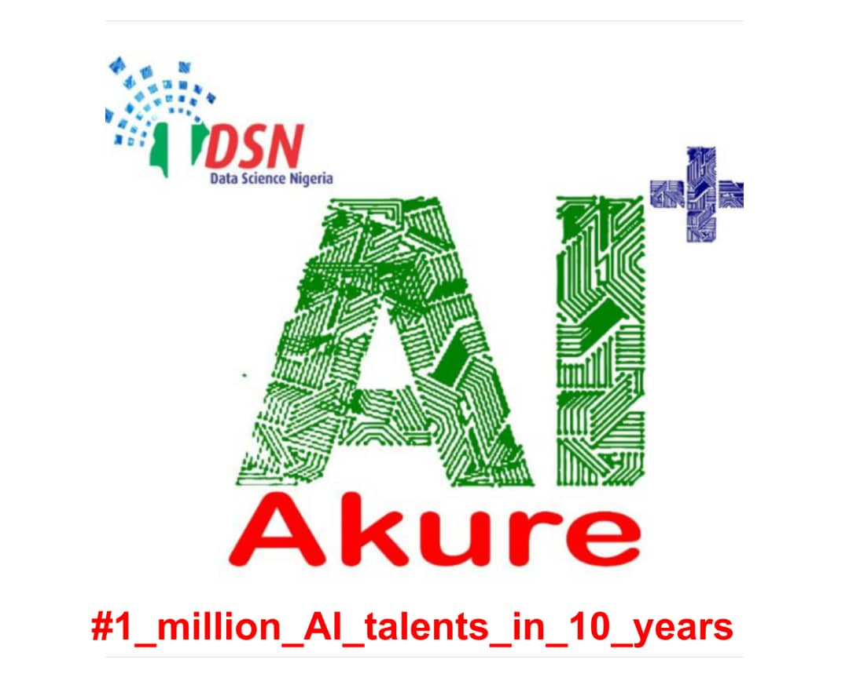
INTRODUCTION TO PYTHON
PROGRAMMING LANGUAGE
BY
TUTOR: JOLAIYA EMMANUEL(@JEAFREEZY)

Slide 2

01
INTRO. TO PYTHON
02
DATA TYPES IN PYTHON
CONTENTS
03
DATA STRUCTURESIN PYTHON
04
CONDITIONALS AND LOOPS
05
FUNCTIONS & METHODS
06
OBJECT ORIENTED PROG.

Slide 3
INTRO TO PYTHON
INTERPRETED,HIGH-LEVEL PROGRAMMING LANGUAGE
CREATED BY GUIDO VAN ROSSUM,FIRST RELEASED IN 1991.
HIGH LEVEL---> CODE READABILITY
USED FOR VARIOUS APPLICATIONS E.G DATA SCIENCE,GIS,WEB DEVELOPMENT(DJANGO,FLASK), MOBILE APP DEVELOPMENT(KIVY), DESKTOP APP DEVELOPMENT,GAMES(PYGAMES) ETC
Read more here: https://www.python.org/

Slide 4
SOME MUST KNOWS
VARIABLES-USED TO STORE DATA.THEY MUST BE:
SNAKE CASE
START WITH LOWERCASE OR UNDERSCORE
CASE SENSITIVE
DON'T OVERWRITE KEYWORDS e.g print(),len() etc
LETTERS,NUMBERS,UNDERSCORES
THEY CAN BE REASSIGNED.
A LINE OF CODE IS A STATEMENT WHILE AN EXPRESSION IS A CODE PERFORMING A SPECIFIC TASKS.

Slide 5
IDEs (INTEGRATED DEVELOPMENT ENVIRONMENTS)
JUPYTER NOTEBOOK (ANACONDA)... Google Colab,repl.it etc

Slide 6
Operators
Arithmetic (+,-,*,/,%,//,**)
Logical (and,or,not,==,<,>,>=,<=,!=)
Augmented Arithemetic (+=,-=)

Slide 7
DATA TYPES IN PYTHON
STRINGS
INTEGERS
BOOLEANS
DICTIONARY
LIST
NONE
FLOATS
COMPLEX
TUPLES
SET

Slide 8
STRINGS
String is traditionally an ordered sequence of characters(letters).
Strings are Immutable
Some built-in functions and methods,that can be used on strings:
len(), str(), upper(), Capitalize(), lower(), find('str'), replace('old','new')
String concatenation,string indexing [start:stop], long strings(''' ''')

Slide 9
DATA STRUCTURES
List
Dictionaries
Tuples
Sets

Slide 10
LIST
They are ordered
Can contain any arbitrary objects
List elements can be accessed by indexing
Lists are mutable
>>> [1,2,3,4] == [4,1,3,2]
>>> False

Slide 11
TUPLES
Tuples are defined in the same way as lists
They are enclosed with parenthesis and not within square brackets
Negative indices are counted from the end of the tuple, just like lists
Commas are used to separate the values same as in a list
Tuples are immutable

Slide 12
DICTIONARIES
They are characterized by keys and values
They are enclosed in curly brackets
The values are accessed by the keys
They can be nested
The values are mutable
Dictionaries are ordered

Slide 13
SETS
Sets are enclosed in curly brackets like dictionaries
They are unordered
They have only values and no keys unlike dictionaries
Set elements are unique i.e. no duplicates
The elements in a set are immutable

Slide 14
Conditionals and Loops
CONDITIONALS
If-else
LOOPS
For loop
While loop

Slide 15
IF, ELSE IF AND ELSE
The if statements are conditional statements used in making decisions
Used to control the flow of code
The flow control is done by using statements and code blocks
It executes a code if it is true
It won't execute the code if it is false
The else if statement is used to add multiple conditional statements extra dynamicism to the flow control
the else statement is executed if the if and else if statements are false

Slide 16
FOR LOOP
For loops are used for iteration
Iteration is the execution of a certain command over multiple times
An iterable is an object used to carry out an iteration
An iterable is an object that can be looped over and over
All data types or data structures are iterables (strings, list, tuple, dict etc)

Slide 17
WHILE LOOP
While loops are used for iteration until a condition is met or not
Extra care should be specified while using while loops to avoid the interpreter from entering an infinite loop, hence crashing the program
The break keyword is used to jump out of a while loop to prevent an infinite loop

Slide 18
FUNCTIONS
No one wants to write a snippet of code for every single time you need a piece of software to do a task for you. That's why in Python you can use functions to get things done faster.
Functions are created/designed to prevent repetition of codes
To reduce code redundancy
To allow for reusability of codes
Functions are defined using the def keyword
Functions takes arguments and parameters
Theyare used for code hiding

Slide 19
METHODS
A python method is somewhat similar to a function except it is associated with object/classes
They are created in a similar way like a function using the def keyword and same syntax except;
A method is used specifically only for the class/object it was created for
A method is accessible to the data contained within the class

Slide 20
Object Oriented Programming (OOP)
OOP in Python focuses on creating reusable codes
The concept of OOP is centered around classes
Classes are defined using the class keyword
OOP allows for flexibility and proper organization of codes for code resuability, structuring and for reducing code redundancy
OOP is built on four mainideas called the FOUR PILLARS OF OOP
Inheritance
Abstraction
Encapsulation
Polymorphism

Slide 21
THANK YOU
JOLAIYA EMMANUEL(@jeafreezy)

